Slide 1

Second hand lens
Solution Design

Slide 2
who we are
Team One – (branches in Thailand and Hong kong)
AO (Project Manager)
Raj (Solution Architect)
Emily (Business Analyst)
Leung (Data Engineer)

Slide 3
Business issues
- Business Analyst and management team can not access report with out support from IT team
- Every store manager can access that stores reports
- Integrate with web portal

Slide 4
Pentaho solutions overview
Standard Report & Dashboard
Self-service Report
Analysis Report
Dashboard
Interactive Report
Data Manipulation
Pentaho Data Integration
Data Modelling
Schema Workbench

Slide 5
solutions on Reporting
Trend Report and Product Category Sales Performance Reports
(For Sales or Marketing Manager)
Dashboard (For CEO)
Cube and Metadata Model

Slide 6
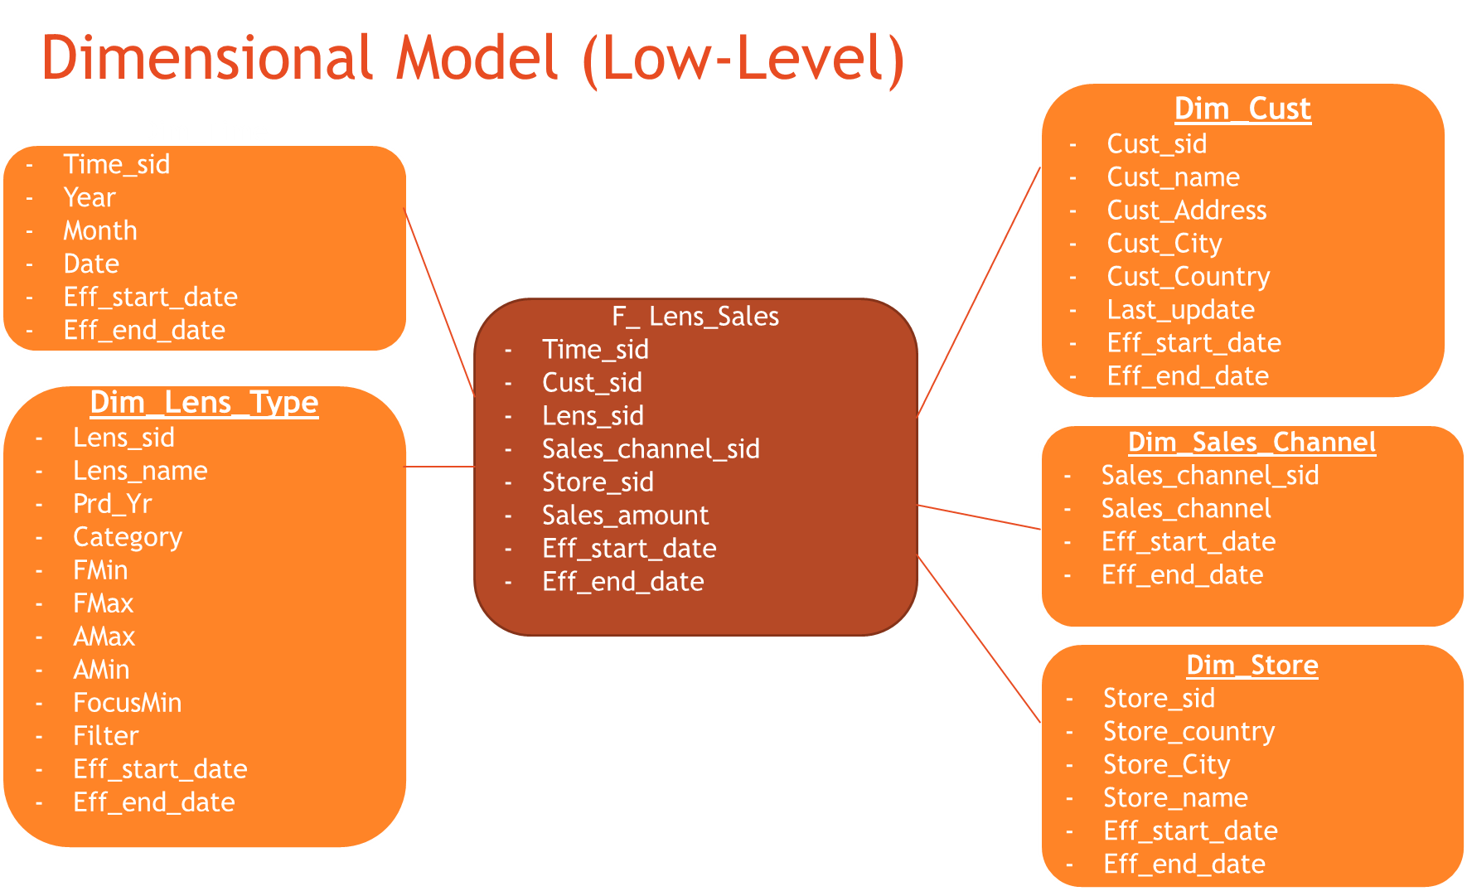
Dimensional model

Slide 7
Data security
Sales Manager can only get his own sales report
CEO can only view the Dashboard

Slide 8
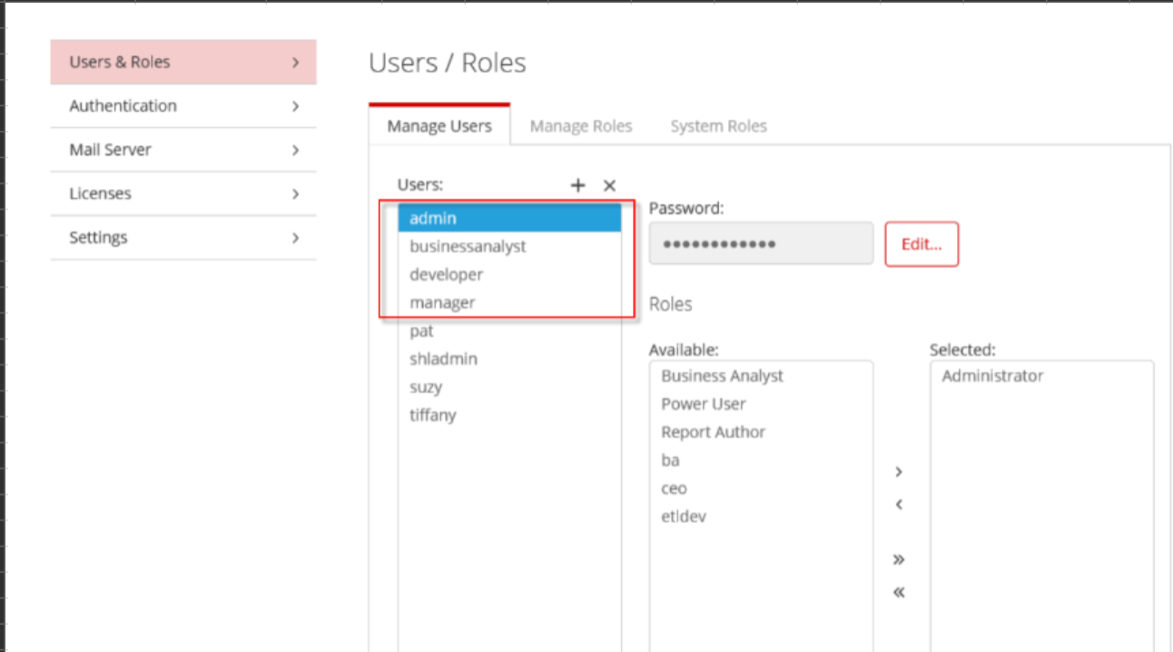
Application level security

Slide 9
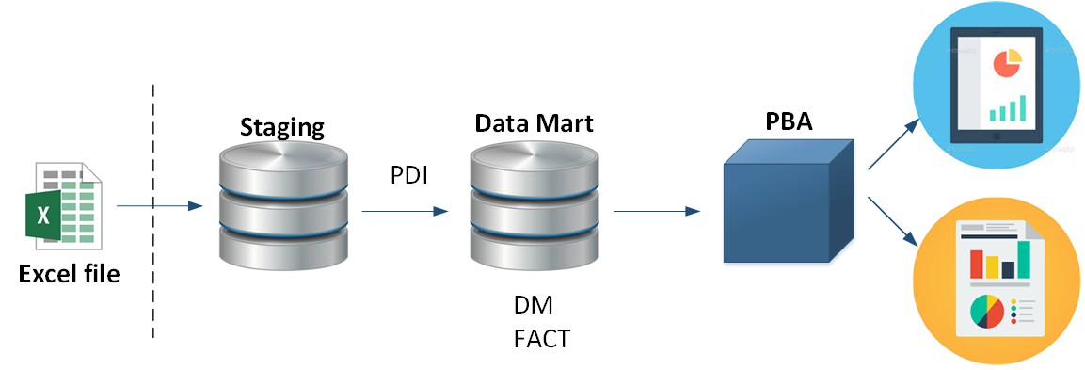
Data flow for Phase 1

Slide 10
Non functional specifications
24/7 availability
User and password management
Data and content security

Slide 11
Phase 2 proposed Solution
Excel upload form to input sales target
Finance Module
Backup & Recovery
Housekeep
Data file (One Month)
Database data (depends on user requirements)
Version and release management
Auto-documentation
Embedding and theming in to Second hand lens web portal

Slide 12
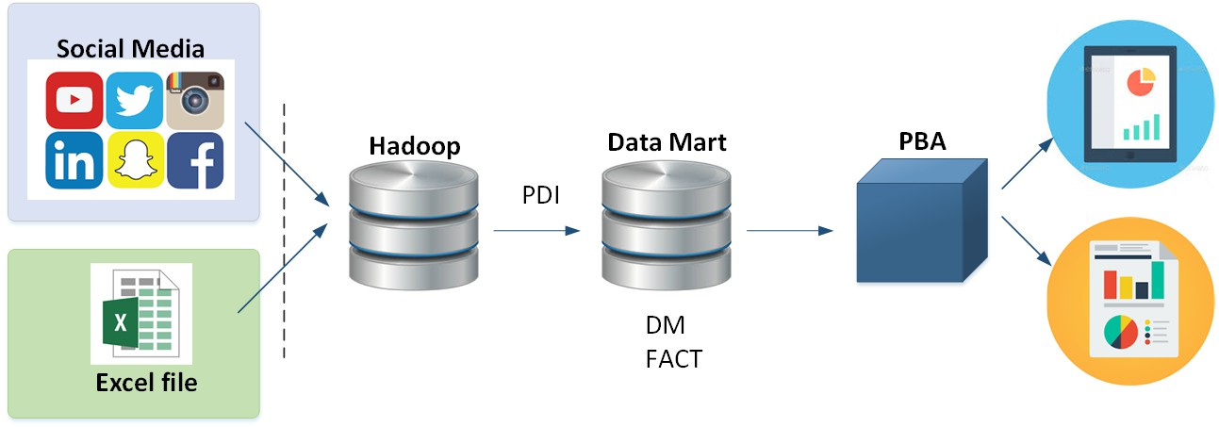
Data flow for Phase 2

Slide 13
Non functional specifications (Phase 2)
Version and release management
Auto-documentation
Auditing and logging
Embedding and theming in to Second hand lens web portal

Slide 14
Data recovery
- In the event of data storage, infrastructure failure the maximum period of acceptable data loss is 24 hours.
- Over weekend or holiday periods, this should equate to 72 hours from the last working day.

